Slide 1
Fragments in Android

Slide 2
Fragments
Fragment class in Android is used for modular UI design. A fragment resides within an Activity but it has its own input events and life cycle.
Fragments are useful when you are designing your application to fit into multiple screen sizes. Since Fragments were introduced with Honeycomb, hence if you want to use them in your application an still want to support Android versions prior to Honeycomb, you must use Android Support libraries. If you decide that the minimum API level your app requires is 11 or higher, you don't need to use the Support Library and can instead use the framework's built in Fragment class and related APIs.

Slide 3
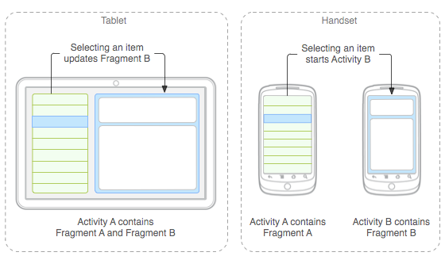
Fragments & its usage
If your application is running on a tab then you get more screen real estate. If the same app runs on a mobile with smaller screen, you need to accommodate the larger layout into two screens. With the fragments, these kind of situations can be handled with ease.

Slide 4
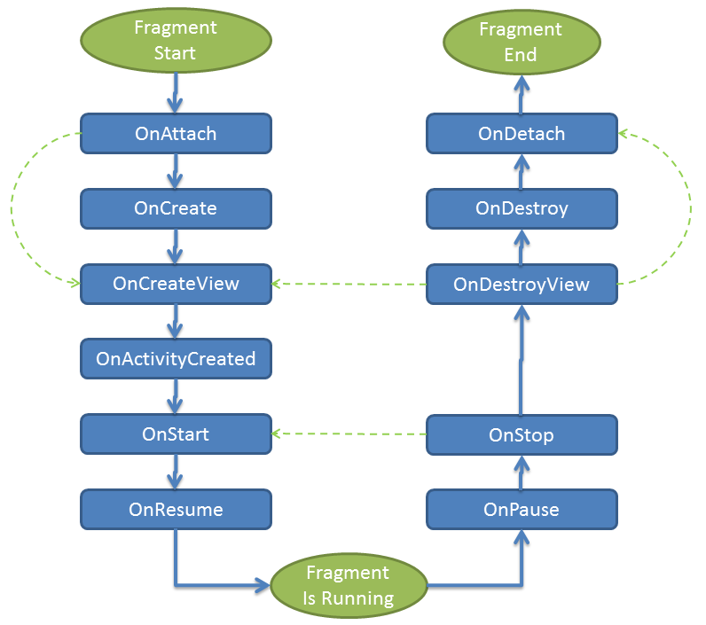
Fragment Lifecycle

Slide 5
Fragment has many methods which can be overridden to plug into the lifecycle (similar to an Activity):
onAttach() is called when a fragment is connected to an activity.
onCreate() is called to do initial creation of the fragment.
onCreateView() is called by Android once the Fragment should inflate a view.
onActivityCreated() is called when host activity has completed its onCreate()method.
onStart() is called once the fragment gets visible.
onResume() - Allocate “expensive” resources such as registering for location, sensor updates, etc.
onPause() - Release “expensive” resources. Commit any changes.
onDestroyView() is called when fragment's view is being destroyed, but the fragment is still kept around.
onDestroy() is called when fragment is no longer in use.
onDetach() is called when fragment is no longer connected to the activity.

Slide 6
The most common ones to override are :
onCreateView - use it for view initialization
onCreate – use it for data initialization
onActivityCreated – use it for tasks which require Activity to be ready

Slide 7
Creating a Fragment
Steps involved in creating a fragment can be logically stated as:
Create a JAVA class that extends Fragment or its subclass.
Create layout xml file for the Fragment.
Create a JAVA class for your Activity.
Create your Activity’s layout xml file and add your fragments there.

Slide 8
Creating Fragments Dynamically
The second way is by adding the fragment dynamically in Java using theFragmentManager. The FragmentManager class and the FragmentTransaction class allow you to add, remove and replace fragments in the layout of your activity.
In this case, you need a "placeholder" FrameLayout that can later be replaced with the fragment. For example:
1. We can have a FrameLayout like below added to the layout file:
<FrameLayout
android:id="@+id/your_placeholder" android:layout_height="match_parent">
</FrameLayout>
2. Now using the following JAVA code, we can replace it at run time with our Fragment as shown next:

Slide 9
//Get FragmentTransaction
FragmentTransaction ft = getFragmentManager().beginTransaction();
// Replace the container with the new fragment
ft.replace(R.id.dynamicFrame, new FirstFragment());
ft.commit();

